Slide 1
Module 3.1: Sigmoid Neuron
CS7015 (Deep Learning) : Lecture 3

Slide 2
The story ahead ...
Enough about boolean functions!
What about arbitrary functions of the form y = f (x) where x ∈ R^{n} (instead of
{0, 1}^{n}) and y ∈ R (instead of {0, 1}) ?
Can we have a network which can (approximately) represent such functions ?
Before answering the above question we will have to first graduate from per- ceptrons to sigmoidal neurons ...
CS7015 (Deep Learning) : Lecture 3

Slide 3
Recall
A perceptron will fire if the weighted sum of its inputs is greater than the threshold (-w₀)
CS7015 (Deep Learning) : Lecture 3

Slide 4
y
The thresholding logic used by a perceptron is very harsh !
For example, let us return to our problem of deciding whether we will like or dislike a movie
Consider that we base our decision only on one input (x₁ = criticsRating which lies between 0 and 1)
bias = w₀ = −0.5
w₁ = 1
x₁ criticsRating
If the threshold is 0.5 (w₀ = −0.5) and w₁ = 1
then what would be the decision for a movie with criticsRating = 0.51 ? (like)
What about a movie with criticsRating =
0.49 ? (dislike)
It seems harsh that we would like a movie with rating 0.51 but not one with a rating of 0.49
CS7015 (Deep Learning) : Lecture 3

Slide 5
This behavior is not a characteristic of the specific problem we chose or the specific weight and threshold that we chose
It is a characteristic of the perceptron function itself which behaves like a step function
1
y
There will always be this sudden change in the
Σ
decision (from 0 to 1) when the threshold (-w₀)
n i=1
w_{i}x_{i} crosses
For most real world applications we would expect a smoother decision function which gradually changes from 0 to 1
Σ
-w₀ n i=1
z=
w_{i}x_{i}
CS7015 (Deep Learning) : Lecture 3

Slide 6
Introducing sigmoid neurons where the out- put function is much smoother than the step function
Here is one form of the sigmoid function called the logistic function
1
y
1
y =
Σ
n
1 + e
−(w + w_{i}x_{i})
0
i=1
We no longer see a sharp transition around the threshold -w₀
Also the output y is no longer binary but a real value between 0 and 1 which can be in- terpreted as a probability
Instead of a like/dislike decision we get the probability of liking the movie
Σ
-w₀ n i=1
z=
w_{i}x_{i}
CS7015 (Deep Learning) : Lecture 3

Slide 7
Perceptron
y
Sigmoid (logistic) Neuron
y
σ
w₀ = −θ
x₀ = 1
w₁ w₂
.. ..
w_{n}
w₀ = −θ
x₀ = 1
w₁ w₂ .. .. w_{n}
x₁ x₂
..
..
x_{n}
x₁ x₂ .. .. x_{n}
n
Σ
1
y = 1 if w ∗ x ≥ 0
y =
Σ
i i
n
1 + e
−( w_{i}x_{i})
i=0
i=0
n
Σ
= 0 if w ∗ x < 0
i i
i=0
CS7015 (Deep Learning) : Lecture 3

Slide 8
Perceptron
Sigmoid Neuron
1
1
y
y
Σ
-w₀ n i=1
Σ
-w₀ n i=1
z=
w_{i}x_{i}
z=
w_{i}x_{i}
Not smooth, not continuous (at w0), not
Smooth, continuous, differentiable
differentiable
CS7015 (Deep Learning) : Lecture 3

Slide 9
Module 3.2: A typical Supervised Machine Learning Setup
CS7015 (Deep Learning) : Lecture 3

Slide 10
What next ?
Sigmoid (logistic) Neuron
y
Well, just as we had an algorithm for learn- ing the weights of a perceptron, we also need a way of learning the weights of a sigmoid neuron
Before we see such an algorithm we will revisit the concept of error
w₀ = −θ
x₀ = 1
w₁ w₂ .. .. w_{n}
x₁ x₂
..
..
x_{n}
CS7015 (Deep Learning) : Lecture 3

Slide 11
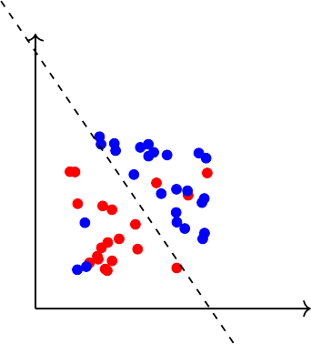
Earlier we mentioned that a single perceptron cannot deal with this data because it is not linearly separable
What does “cannot deal with” mean?
What would happen if we use a perceptron model to classify this data ?
We would probably end up with a line like this ... This line doesn’t seem to be too bad
Sure, it misclassifies 3 blue points and 3 red points but we could live with this error in most real world applications
From now on, we will accept that it is hard to drive the error to 0 in most cases and will instead aim to reach the minimum possible error
CS7015 (Deep Learning) : Lecture 3

Slide 12
This brings us to a typical machine learning setup which has the following components...
Data: {x , y }
n
i i
i=1
Model: Our approximation of the relation between x and y. For example,
1
yˆ =
_{1 + e}−(w^{T}x)
or yˆ = w^{T}x
or yˆ = x^{T}Wx
or just about any function
Parameters: In all the above cases, w is a parameter which needs to be learned from the data
Learning algorithm: An algorithm for learning the parameters (w) of the model (for example, perceptron learning algorithm, gradient descent, etc.) Objective/Loss/Error function: To guide the learning algorithm - the learn- ing algorithm should aim to minimize the loss function
CS7015 (Deep Learning) : Lecture 3

Slide 13
As an illustration, consider our movie example
Data: {x = movie, y = like/dislike}
n
i i
i=1
Model: Our approximation of the relation between x and y (the probability of liking a movie).
1
yˆ =
_{1 + e}−(w^{T}x)
Parameter: w
Learning algorithm: Gradient Descent [we will see soon]
Objective/Loss/Error function: One possibility is
n
Σ
L (w) = (yˆ − y )
2
i i
i=1
The learning algorithm should aim to find a w which minimizes the above function (squared error between y and yˆ)
CS7015 (Deep Learning) : Lecture 3

Slide 14
Module 3.3: Learning Parameters: (Infeasible) guess work
CS7015 (Deep Learning) : Lecture 3

Slide 15
Keeping this supervised ML setup in mind, we will now focus on this model and discuss an algorithm for learning the parameters of this model from some given data using an appropriate objective function
y
σ
σ stands for the sigmoid function (logistic function in this case)
For ease of explanation, we will consider a very simplified version of the model having just 1 input
Further to be consistent with the literature, from now on, we will refer to w₀ as b (bias)
Lastly, instead of considering the problem of predicting like/dislike, we will assume that we want to predict criticsRating(y) given imdbRating(x) (for no particular reason)
17/70
w₀ = −θ
x₀ = 1
w₁ w₂
.. ..
w_{n}
x₁ x₂
..
..
x_{n}
f (x) = ¹
_{1+e}−(w·x+b)
x
w b
σ
yˆ = f (x)
1
f (x) = ¹
_{1+e}−(w·x+b)
CS7015 (Deep Learning) : Lecture 3

Slide 16
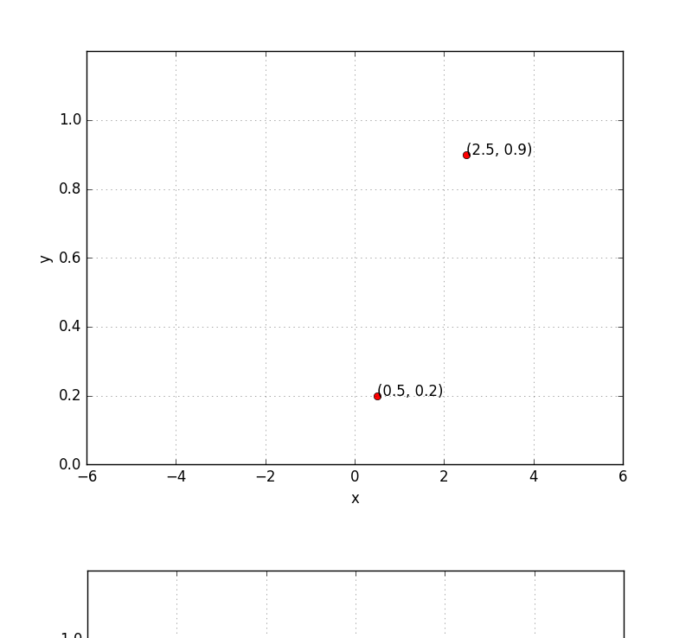
yˆ = f (x)
x
w b
σ
Input for training
N
1
{x , y } → N pairs of (x, y)
i i
i=1
f (x) = ¹
Training objective
_{1+e}−(w·x+b)
Find w and b such that:
N
Σ
minimize L (w, b) = (y − f (x ))
2
i i
w,b
i=1
What does it mean to train the network? Suppose we train the network with (x, y) = (0.5, 0.2) and (2.5, 0.9)
At the end of training we expect to find w*, b* such that:
f (0.5) → 0.2 and f (2.5) → 0.9
CS7015 (Deep Learning) : Lecture 3

Slide 17
Let us see this in more detail....
CS7015 (Deep Learning) : Lecture 3

Slide 18
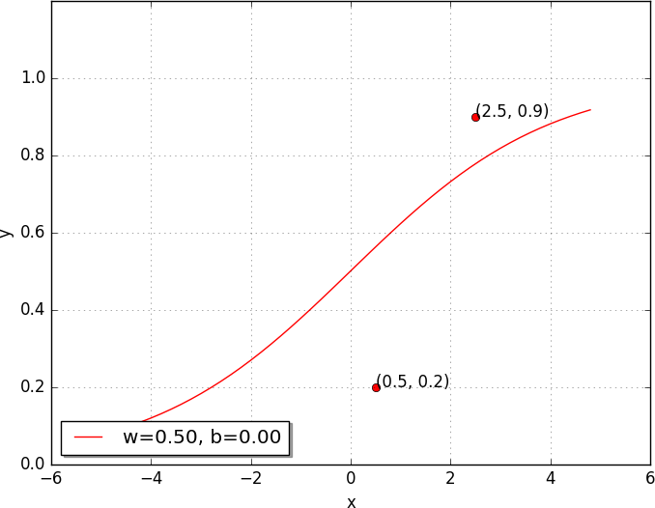
Can we try to find such a w∗, b∗ manually
Let us try a random guess.. (say, w = 0.5, b = 0) Clearly not good, but how bad is it ?
Let us revisit L (w, b) to see how bad it is ...
N
1
Σ
L (w, b) = ∗ (y − f (x ))
2
2
i i
i=1
1
2 2
= ∗ (y − f (x )) + (y − f (x ))
2
1 1 2 2
1
σ(x) =
_{1 + e}−(wx+b)
1
2
2
= ∗ (0.9 − f (2.5)) + (0.2 − f (0.5))
2
= 0.073
We want L (w, b) to be as close to 0 as possible
20/70
CS7015 (Deep Learning) : Lecture 3

Slide 19
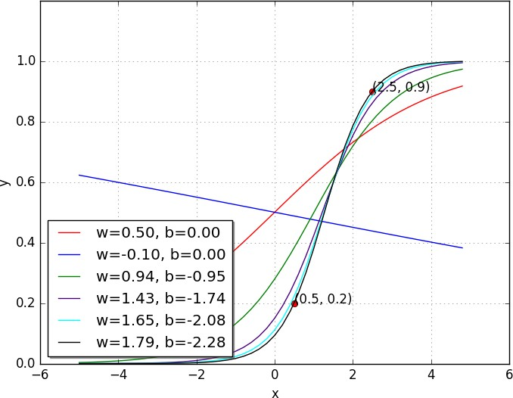
Let us try some other values of w, b
w | b | L (w, b)
0.50 | 0.00 | 0.0730
-0.10 | 0.00 | 0.1481
0.94 | -0.94 | 0.0214
1.42 | -1.73 | 0.0028
1.65 | -2.08 | 0.0003
1.78 | -2.27 | 0.0000
Oops!! this made things even worse...
Perhaps it would help to push w and b in the other direction...
Let us keep going in this direction, i.e., increase
w and decrease b
With some guess work and intuition we were able
1
σ(x) =
_{1 + e}−(wx+b)
to find the right values for w and b
21/70
Mitesh M. Khapra CS7015 (Deep Learning) : Lecture 3

Slide 20
Let us look at something better than our “guess work” algorithm....
CS7015 (Deep Learning) : Lecture 3

Slide 21
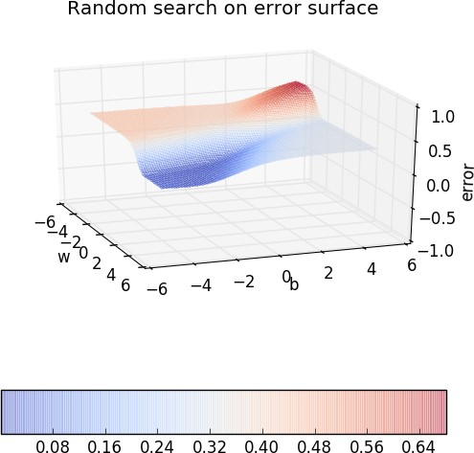
Since we have only 2 points and 2 parameters (w, b) we can easily plot L (w, b) for different values of (w, b) and pick the one where L (w, b) is minimum
But of course this becomes intract- able once you have many more data points and many more parameters !!
Further, even here we have plotted the error surface only for a small range of (w, b) [from (−6, 6) and not from (− inf, inf)]
CS7015 (Deep Learning) : Lecture 3

Slide 22
Let us look at the geometric interpretation of our “guess work” algorithm in terms of this error surface
CS7015 (Deep Learning) : Lecture 3

Slide 23
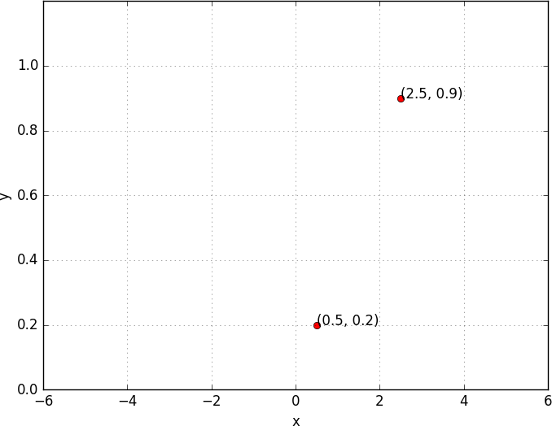
CS7015 (Deep Learning) : Lecture 3

Slide 24

CS7015 (Deep Learning) : Lecture 3

Slide 25
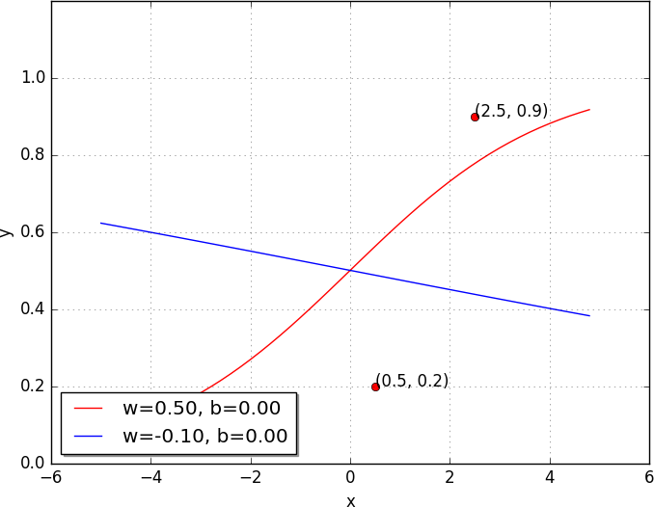

CS7015 (Deep Learning) : Lecture 3

Slide 26
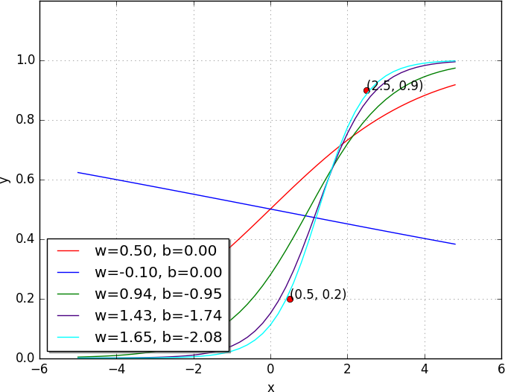

CS7015 (Deep Learning) : Lecture 3

Slide 27
Module 3.4: Learning Parameters : Gradient Descent
CS7015 (Deep Learning) : Lecture 3

Slide 28
Now let us see if there is a more efficient and principled way of doing this
CS7015 (Deep Learning) : Lecture 3

Slide 29
Goal
Find a better way of traversing the error surface so that we can reach the minimum value quickly without resorting to brute force search!
CS7015 (Deep Learning) : Lecture 3

Slide 30
Gradient Descent Rule
The direction u that we intend to move in should be at 180° w.r.t. the gradient
In other words, move in a direction opposite to the gradient
Parameter Update Equations
w_{t+1} = w_{t} − η∇w_{t} b_{t+1} = b_{t} − η∇b_{t}
∂L (w, b)
∂L (w, b)
∂b
where, ∇w =
, ∇b =
t
^{∂w} at w = w , b = b
t t
at w = w , b = b
t t
So we now have a more principled way of moving in the w-b plane than our “guess work” algorithm
CS7015 (Deep Learning) : Lecture 3

Slide 31
Let us create an algorithm from this rule ...
Algorithm: gradient descent()
t ← 0;
max iterations ← 1000;
while t < max iterations do
w_{t+1} ← w_{t} − η∇w_{t}; b_{t+1} ← b_{t} − η∇b_{t};
t ← t + 1;
end
To see this algorithm in practice let us first derive ∇w and ∇b for our toy neural network
CS7015 (Deep Learning) : Lecture 3

Slide 32
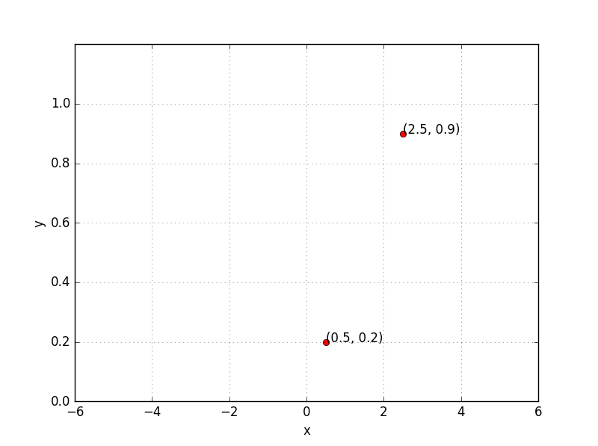
x
σ
y = f (x)
1
So if there is only 1 point (x, y), we have,
f (x) = ¹
_{1+e}−(w·x+b)
∇w = (f (x) − y) ∗ f (x) ∗ (1 − f (x)) ∗ x
For two points,
2
Σ
∇w = (f (x ) − y ) ∗ f (x ) ∗ (1 − f (x )) ∗ x
i i i i
i
i=1
2
Σ
∇b = (f (x ) − y ) ∗ f (x ) ∗ (1 − f (x ))
i i i i
i=1
CS7015 (Deep Learning) : Lecture 3

Slide 33
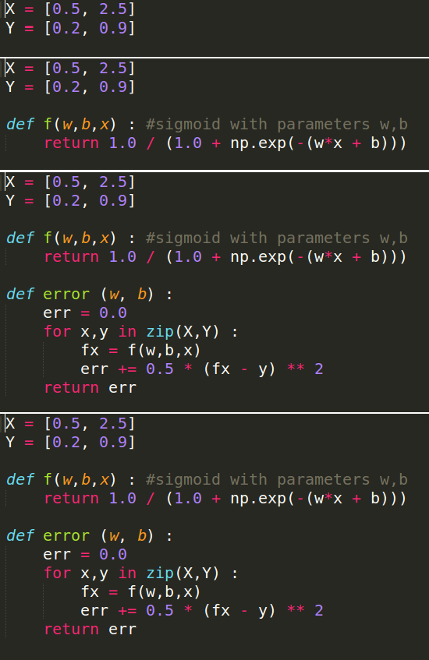
CS7015 (Deep Learning) : Lecture 3

Slide 34
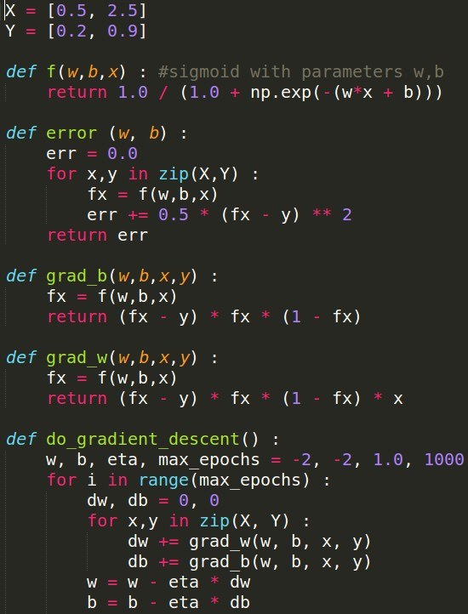
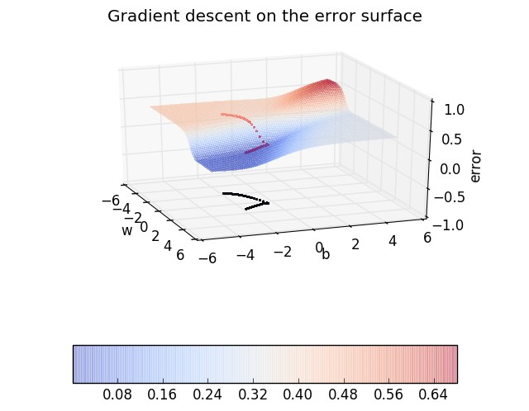
CS7015 (Deep Learning) : Lecture 3

Slide 35
Later on in the course we will look at gradient descent in much more detail and discuss its variants
For the time being it suffices to know that we have an algorithm for learning the parameters of a sigmoid neuron
So where do we head from here ?
CS7015 (Deep Learning) : Lecture 3

Slide 36
Module 3.5: Representation Power of a Multilayer Network of Sigmoid Neurons
CS7015 (Deep Learning) : Lecture 3

Slide 37
Representation power of a mul- tilayer network of perceptrons
Representation power of a mul- tilayer network of sigmoid neurons
A multilayer network of perceptrons with a single hidden layer can be used to rep- resent any boolean function precisely (no errors)
A multilayer network of neurons with a single hidden layer can be used to approx- imate any continuous function to any desired precision
In other words, there is a guarantee that for any function f (x) : R^{n} → R^{m}, we can always find a neural network (with 1 hidden layer containing enough neurons) whose output g(x) satisfies |g(x)− f (x)| < ϵ !!
Proof: We will see an illustrative proof of this... [Cybenko, 1989], [Hornik, 1991]
CS7015 (Deep Learning) : Lecture 3

Slide 38
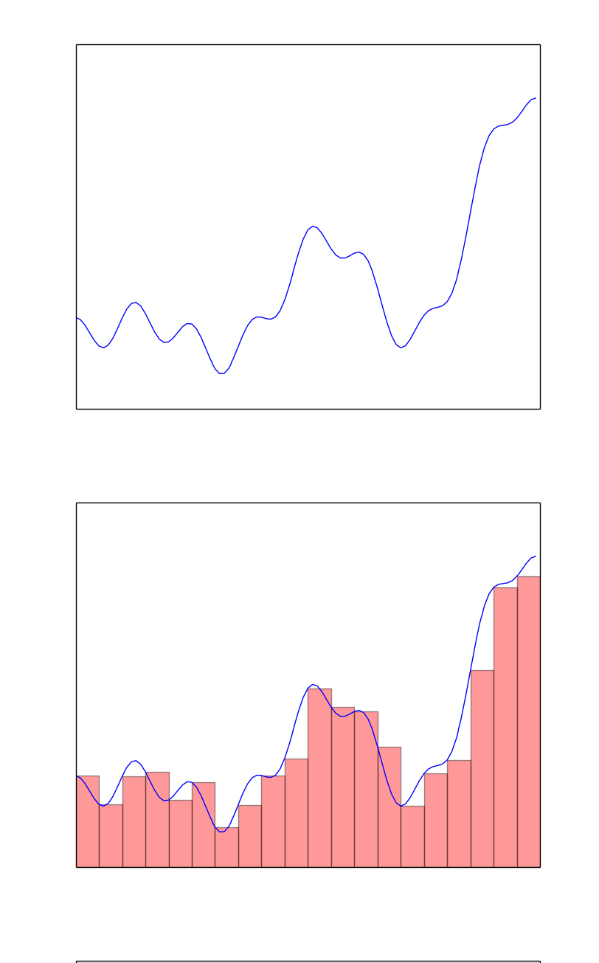
We are interested in knowing whether a network of neurons can be used to represent an arbitrary function (like the one shown in the figure)
We observe that such an arbitrary function can be approximated by sev- eral “tower” functions
More the number of such “tower” functions, better the approximation
To be more precise, we can approxim- ate any arbitrary function by a sum of such “tower” functions
CS7015 (Deep Learning) : Lecture 3

Slide 39
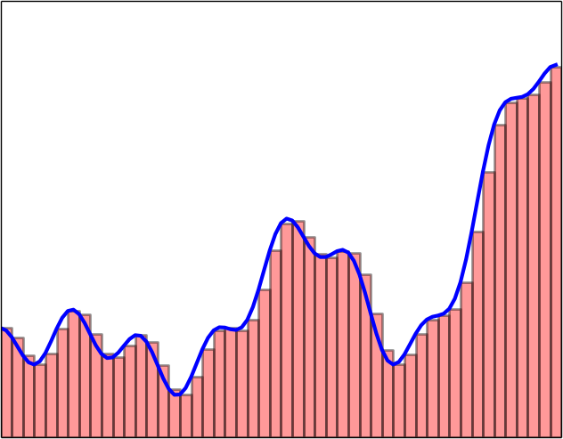




We make a few observations
All these “tower” functions are sim- ilar and only differ in their heights and positions on the x-axis
Suppose there is a black box which takes the original input (x) and con- structs these tower functions
We can then have a simple network which can just add them up to ap- proximate the function
Our job now is to figure out what is inside this blackbox
+
. . .
. . .
Tower Tower .
maker maker
. .
. . .
x
Tower Tower maker maker
CS7015 (Deep Learning) : Lecture 3

Slide 40
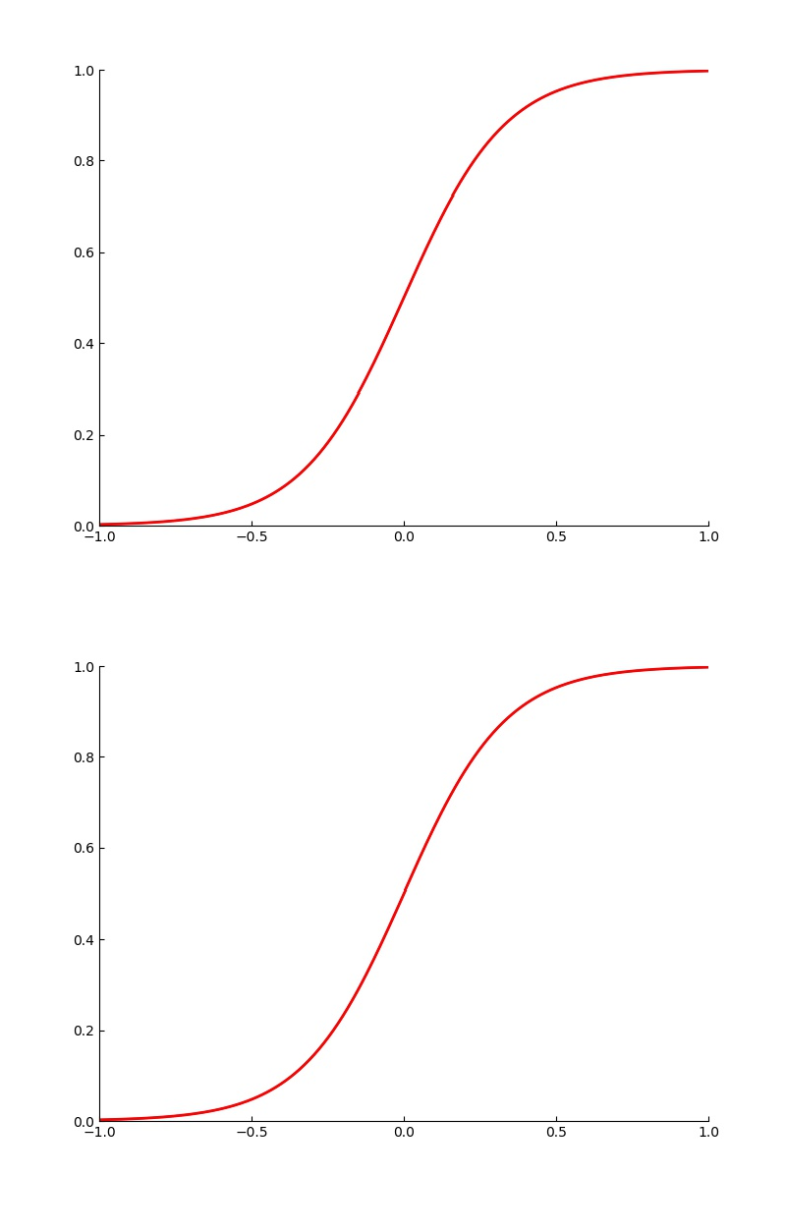
If we take the logistic function and set w to a very high value we will recover the step function
Let us see what happens as we change the value of w
Further we can adjust the value of b to control the position on the x-axis at which the function transitions from 0 to 1
CS7015 (Deep Learning) : Lecture 3

Slide 41
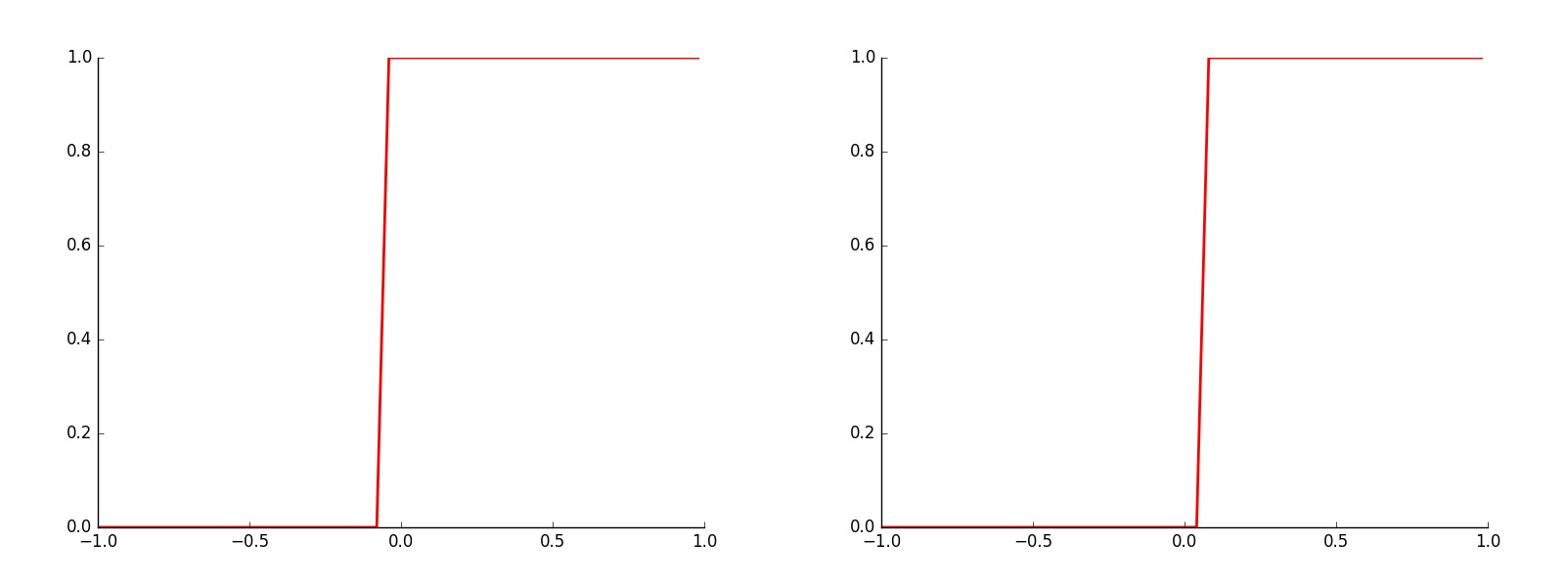
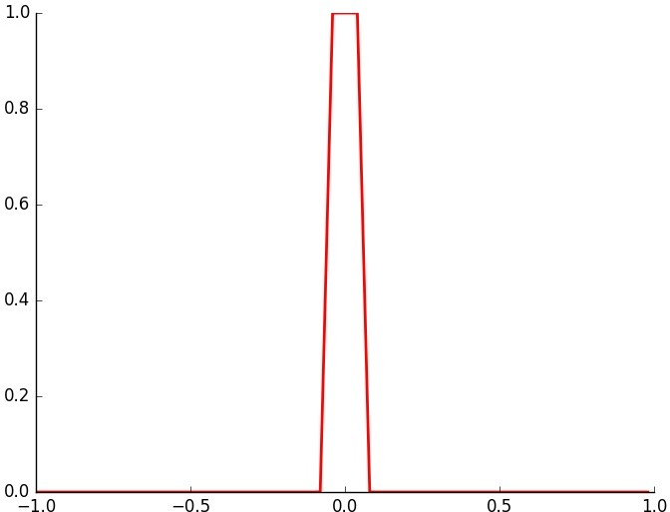
Now let us see what we get by taking two such sigmoid functions (with dif- ferent b^{j}s) and subtracting one from the other
Voila! We have our tower function !!
CS7015 (Deep Learning) : Lecture 3

Slide 42
Can we come up with a neural network to represent this operation of subtracting one sigmoid function from another ?
CS7015 (Deep Learning) : Lecture 3

Slide 43
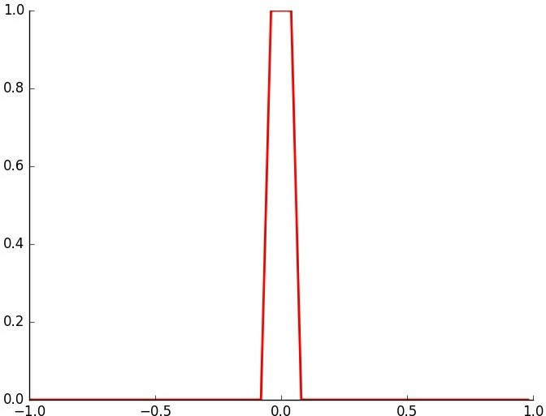

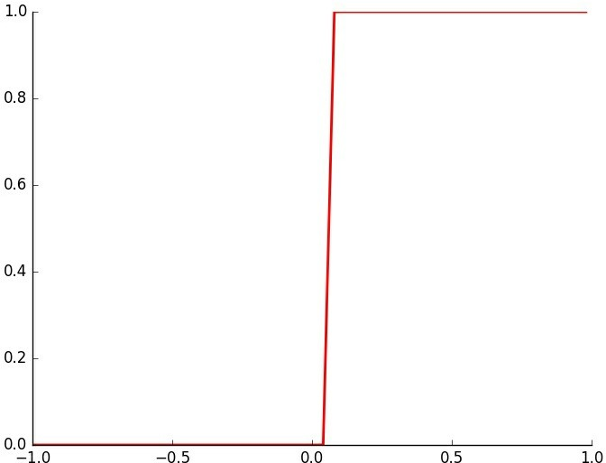
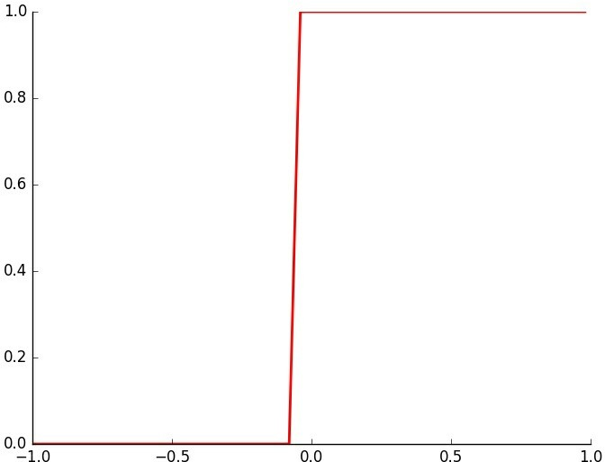
CS7015 (Deep Learning) : Lecture 3

Slide 44
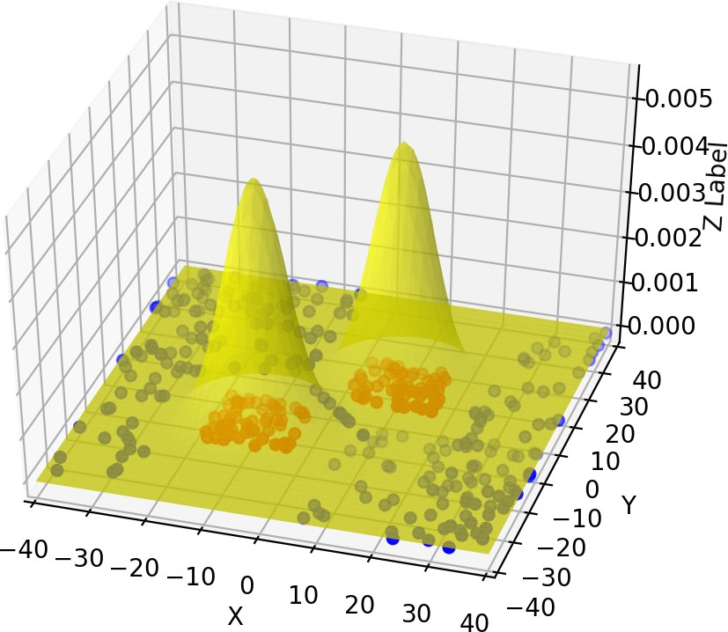
What if we have more than one input?
Suppose we are trying to take a decision about whether we will find oil at a particular location on the ocean bed(Yes/No)
Further, suppose we base our decision on two factors: Salinity (x₁) and Pressure (x₂)
We are given some data and it seems that y(oil|no-oil) is a complex function of x₁ and x₂
We want a neural network to approximate this function
CS7015 (Deep Learning) : Lecture 3

Slide 45
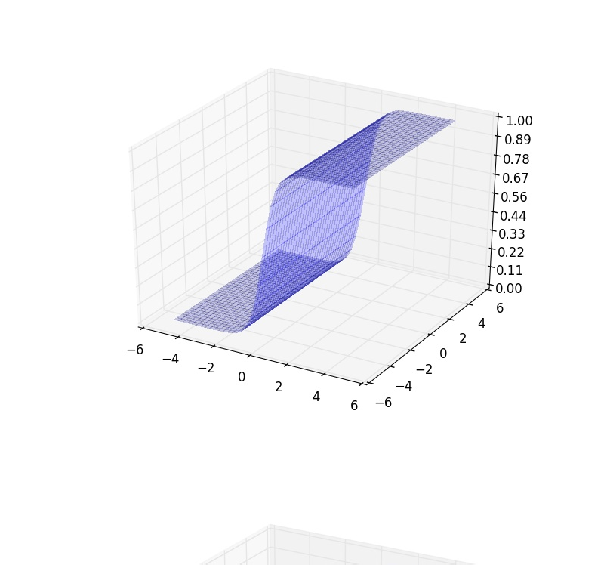
This is what a 2-dimensional sigmoid looks like
We need to figure out how to get a tower in this case
First, let us set w₂ to 0 and see if we can get a two dimensional step func- tion
What would happen if we change b ?
1
y =
_{1 + e}−(w₁x₁+w₂x₂+b)
CS7015 (Deep Learning) : Lecture 3

Slide 46
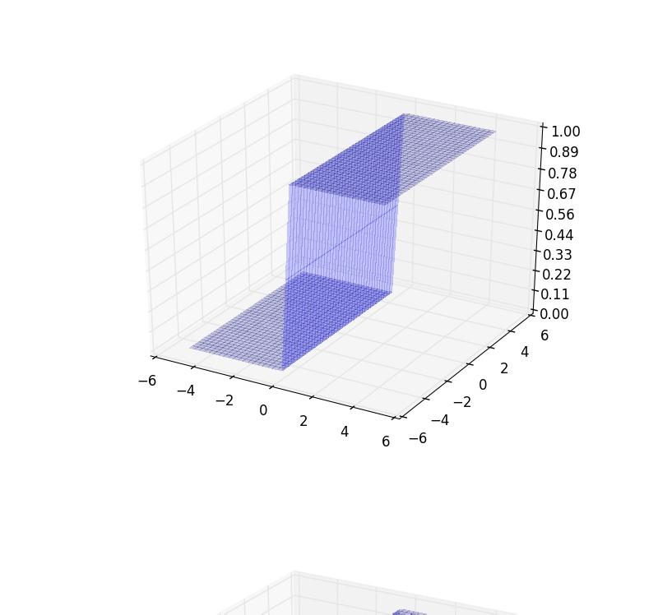
This is what a 2-dimensional sigmoid looks like
We need to figure out how to get a tower in this case
First, let us set w₂ to 0 and see if we can get a two dimensional step func- tion
What would happen if we change b ?
1
y =
_{1 + e}−(w₁x₁+w₂x₂+b)
CS7015 (Deep Learning) : Lecture 3

Slide 47
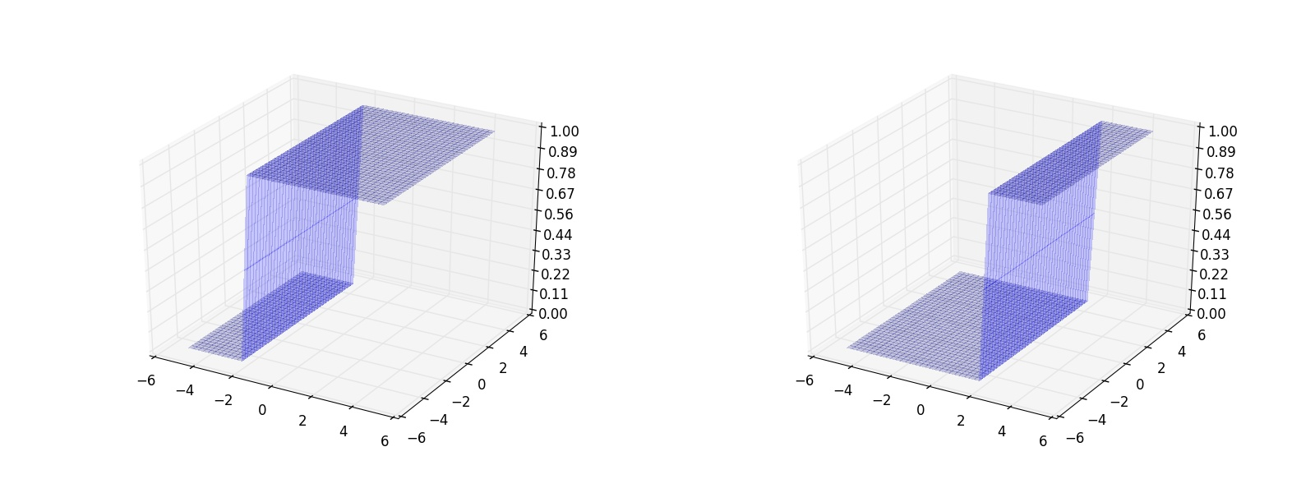
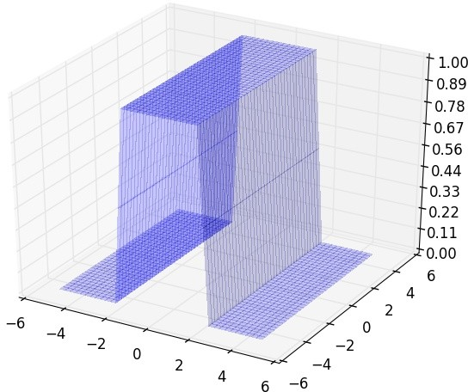
What if we take two such step func- tions (with different b values) and subtract one from the other
We still don’t get a tower (or we get a tower which is open from two sides)
CS7015 (Deep Learning) : Lecture 3

Slide 48
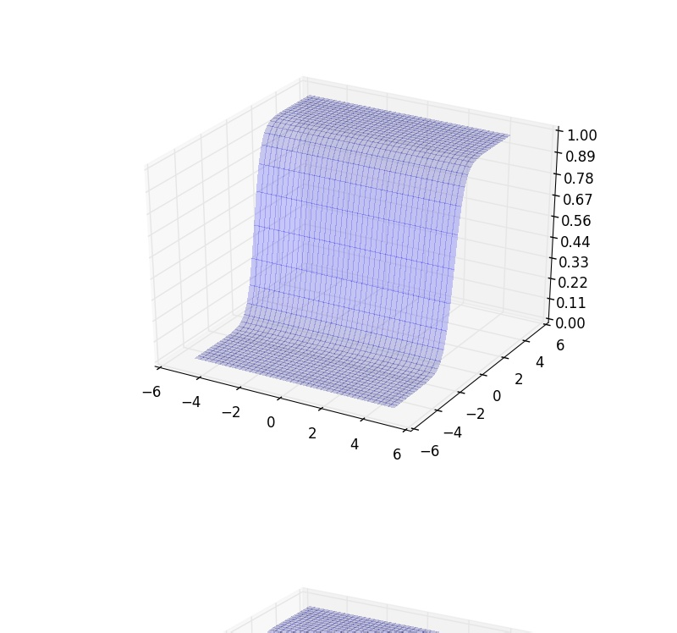
Now let us set w₁ to 0 and adjust w₂ to get a 2-dimensional step function with a different orientation
And now we change b
1
y =
_{1 + e}−(w₁x₁+w₂x₂+b)
CS7015 (Deep Learning) : Lecture 3

Slide 49

Now let us set w₁ to 0 and adjust w₂ to get a 2-dimensional step function with a different orientation
And now we change b
1
y =
_{1 + e}−(w₁x₁+w₂x₂+b)
CS7015 (Deep Learning) : Lecture 3

Slide 50
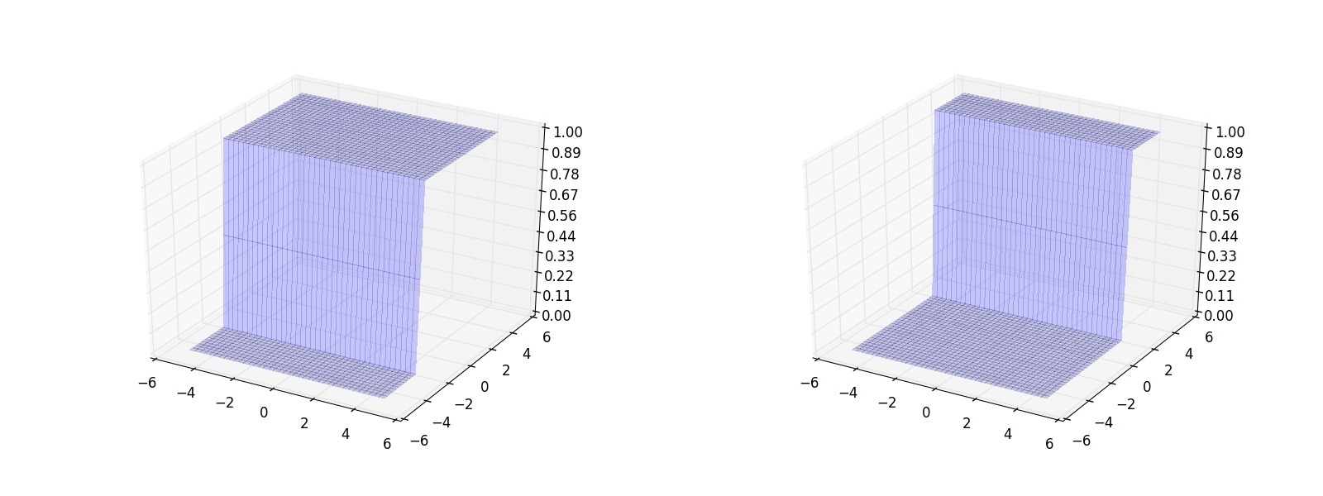
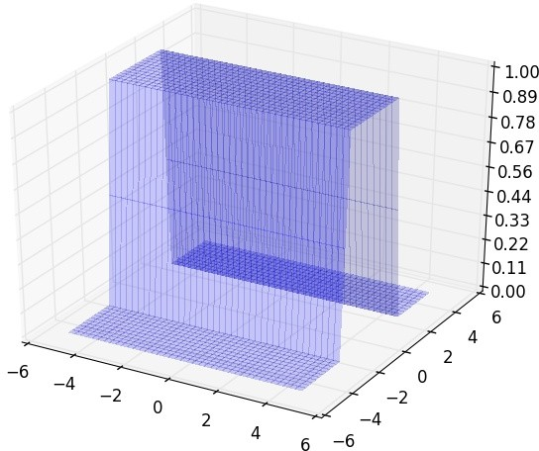
Again, what if we take two such step functions (with different b values) and subtract one from the other
We still don’t get a tower (or we get a tower which is open from two sides)
Notice that this open tower has a dif- ferent orientation from the previous one
CS7015 (Deep Learning) : Lecture 3

Slide 51
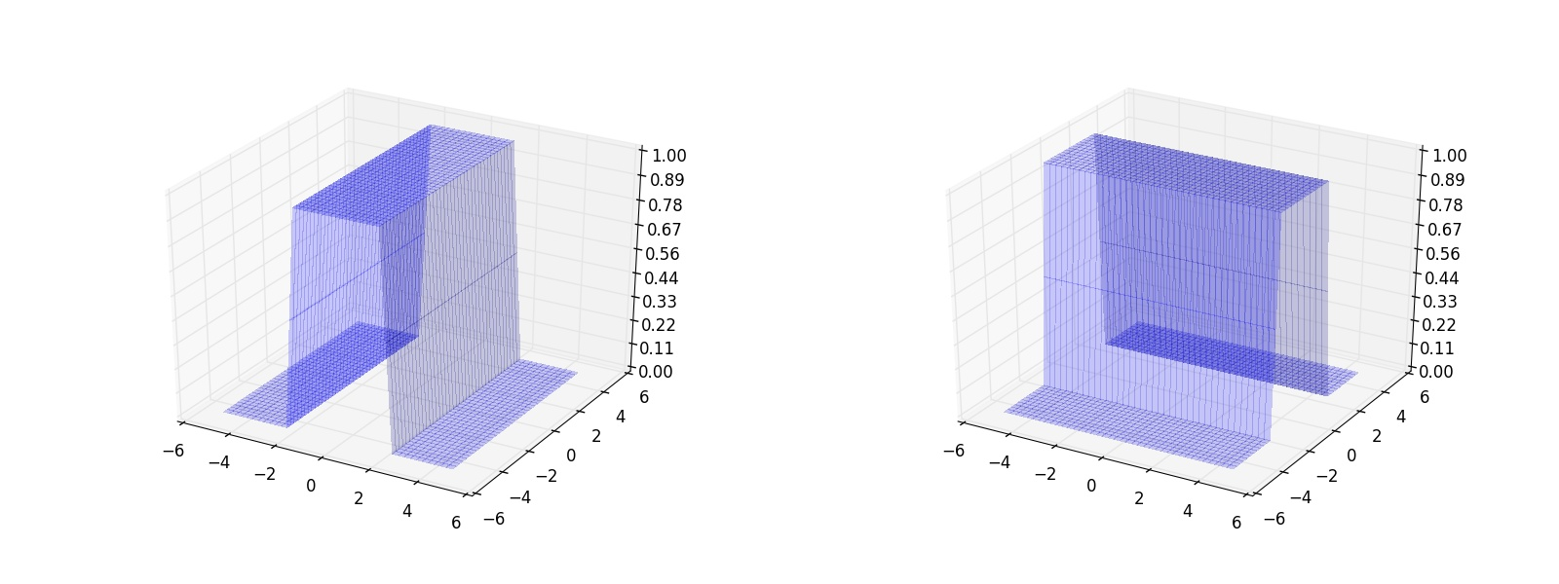
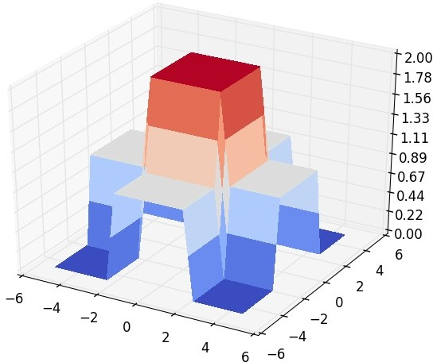
Now what will we get by adding two such open towers ?
We get a tower standing on an elev- ated base
We can now pass this output through another sigmoid neuron to get the de- sired tower !
We can now approximate any func- tion by summing up many such towers
CS7015 (Deep Learning) : Lecture 3

Slide 52
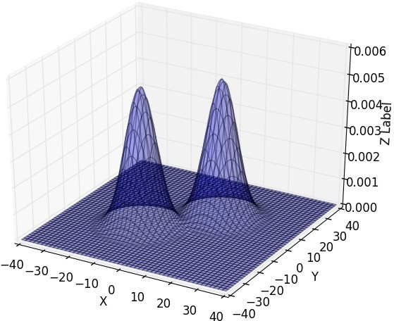
For example, we could approximate the following function using a sum of several towers
CS7015 (Deep Learning) : Lecture 3

Slide 53
Can we come up with a neural network to represent this entire procedure of constructing a 3 dimensional tower ?
CS7015 (Deep Learning) : Lecture 3

Slide 54
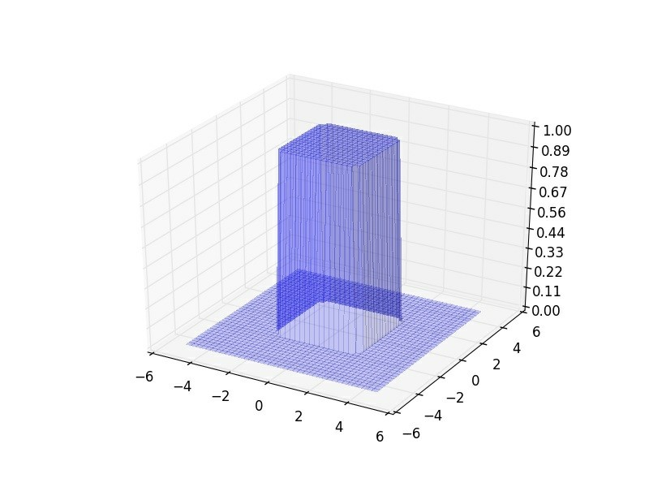


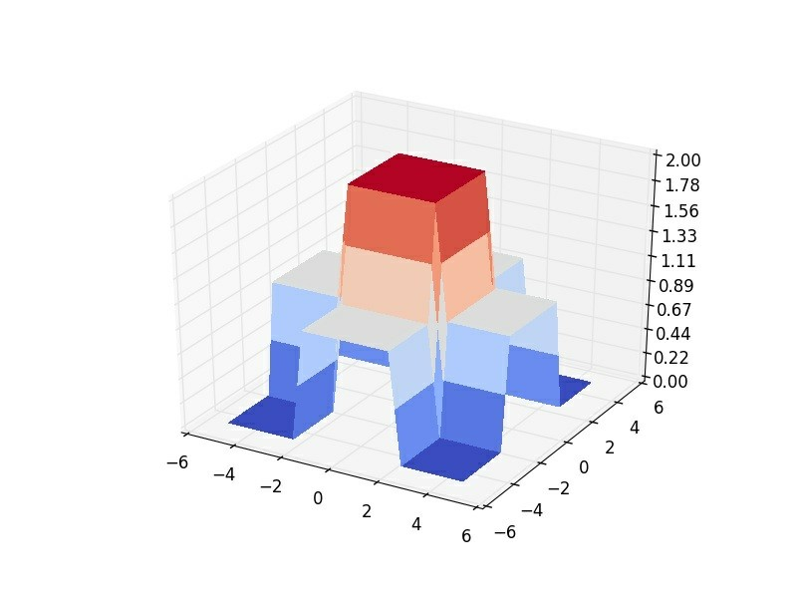
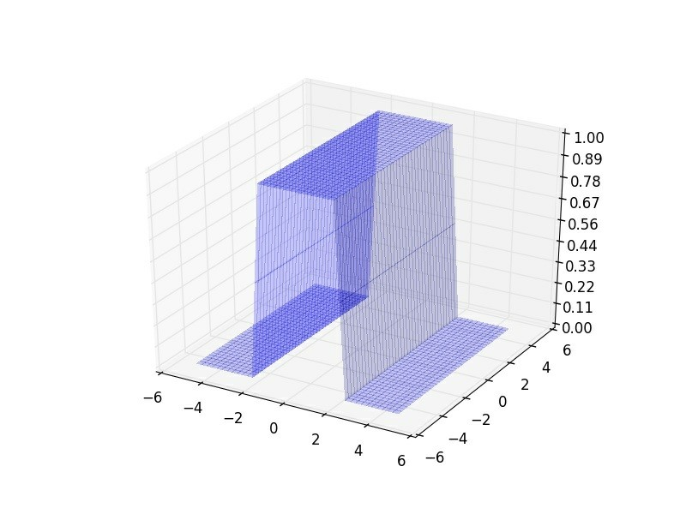
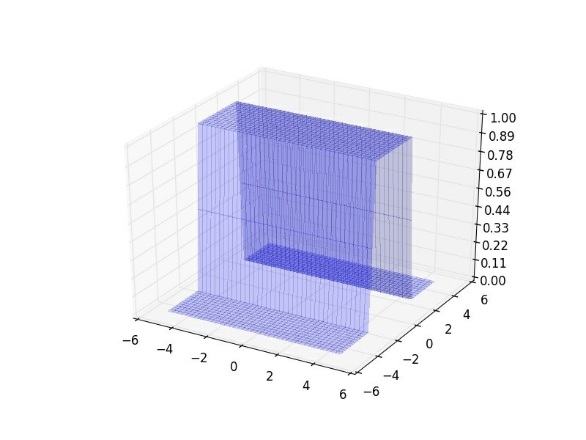
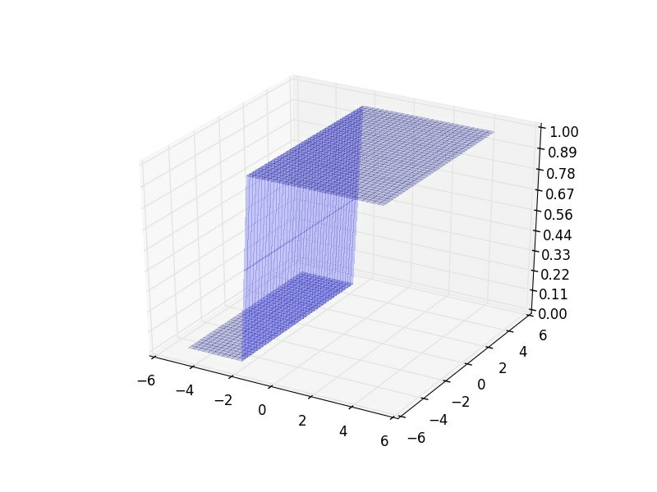
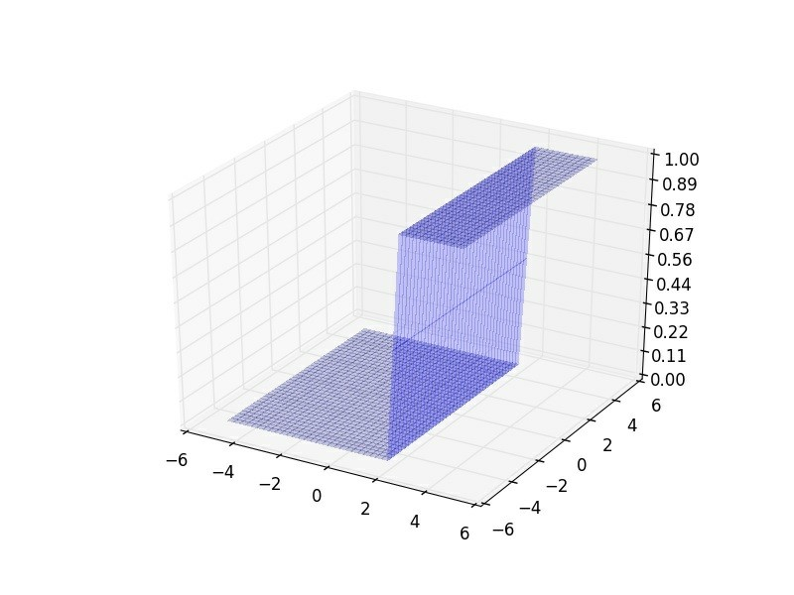
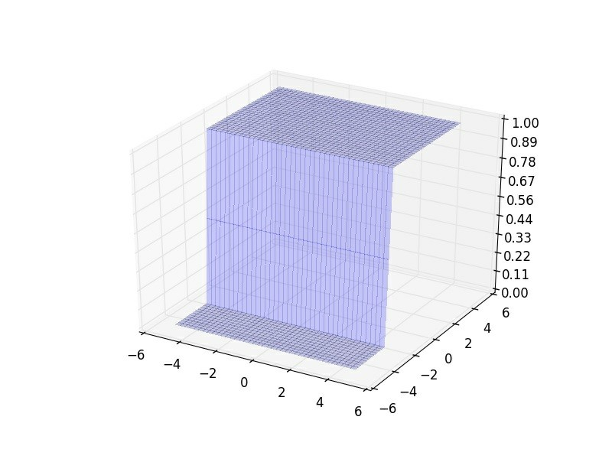
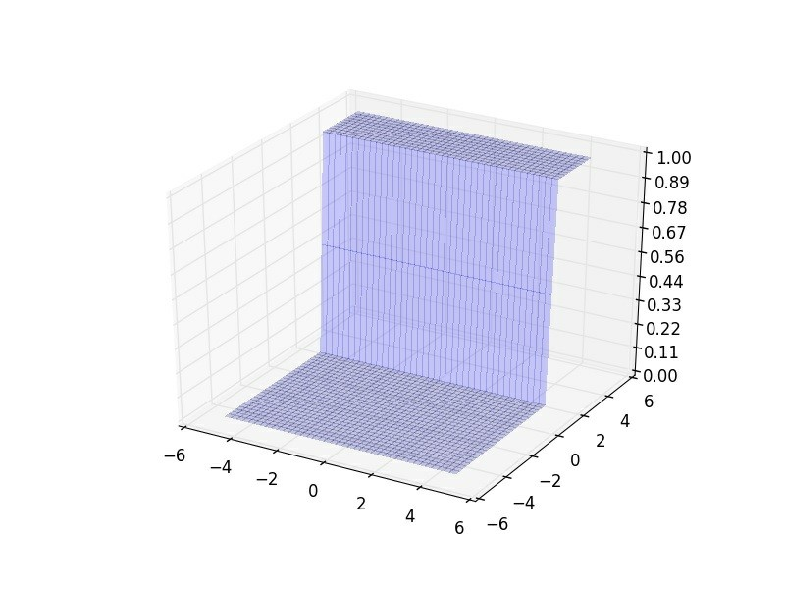
CS7015 (Deep Learning) : Lecture 3

Slide 55
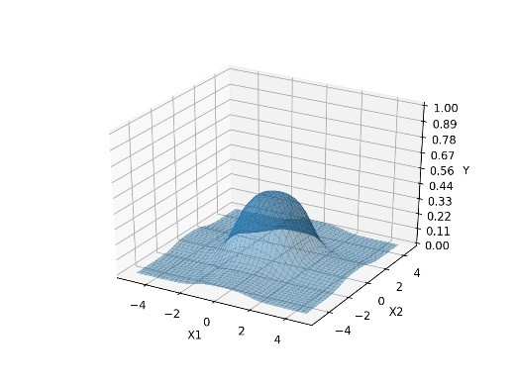
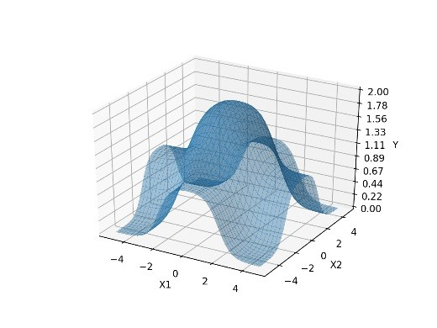
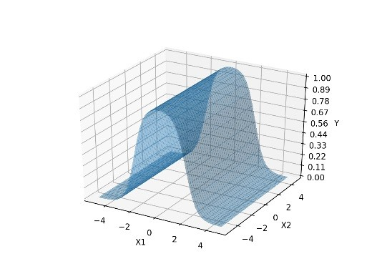
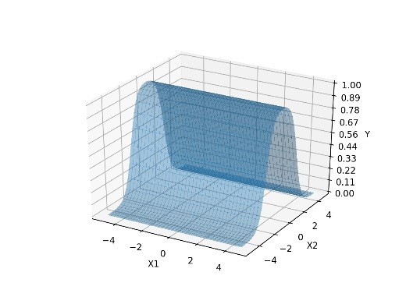
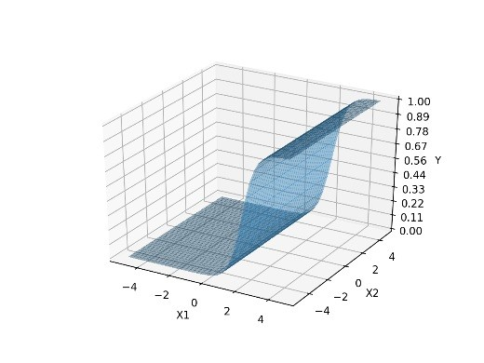
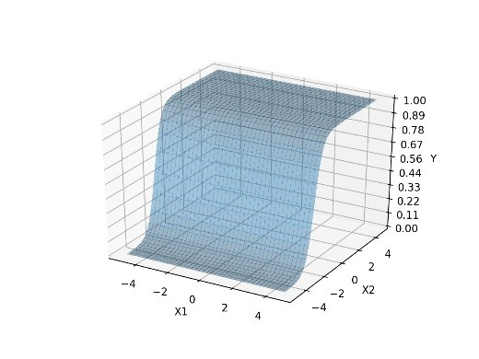
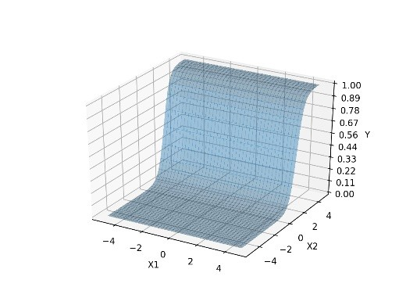
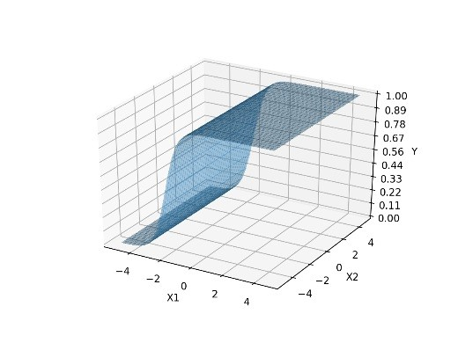

CS7015 (Deep Learning) : Lecture 3

Slide 56
Think
For 1 dimensional input we needed 2 neurons to construct a tower For 2 dimensional input we needed 4 neurons to construct a tower
How many neurons will you need to construct a tower in n dimensions ?
CS7015 (Deep Learning) : Lecture 3

Slide 57
Time to retrospect
Why do we care about approximating any arbitrary function ?
Can we tie all this back to the classification problem that we have been dealing with ?
CS7015 (Deep Learning) : Lecture 3

Slide 58
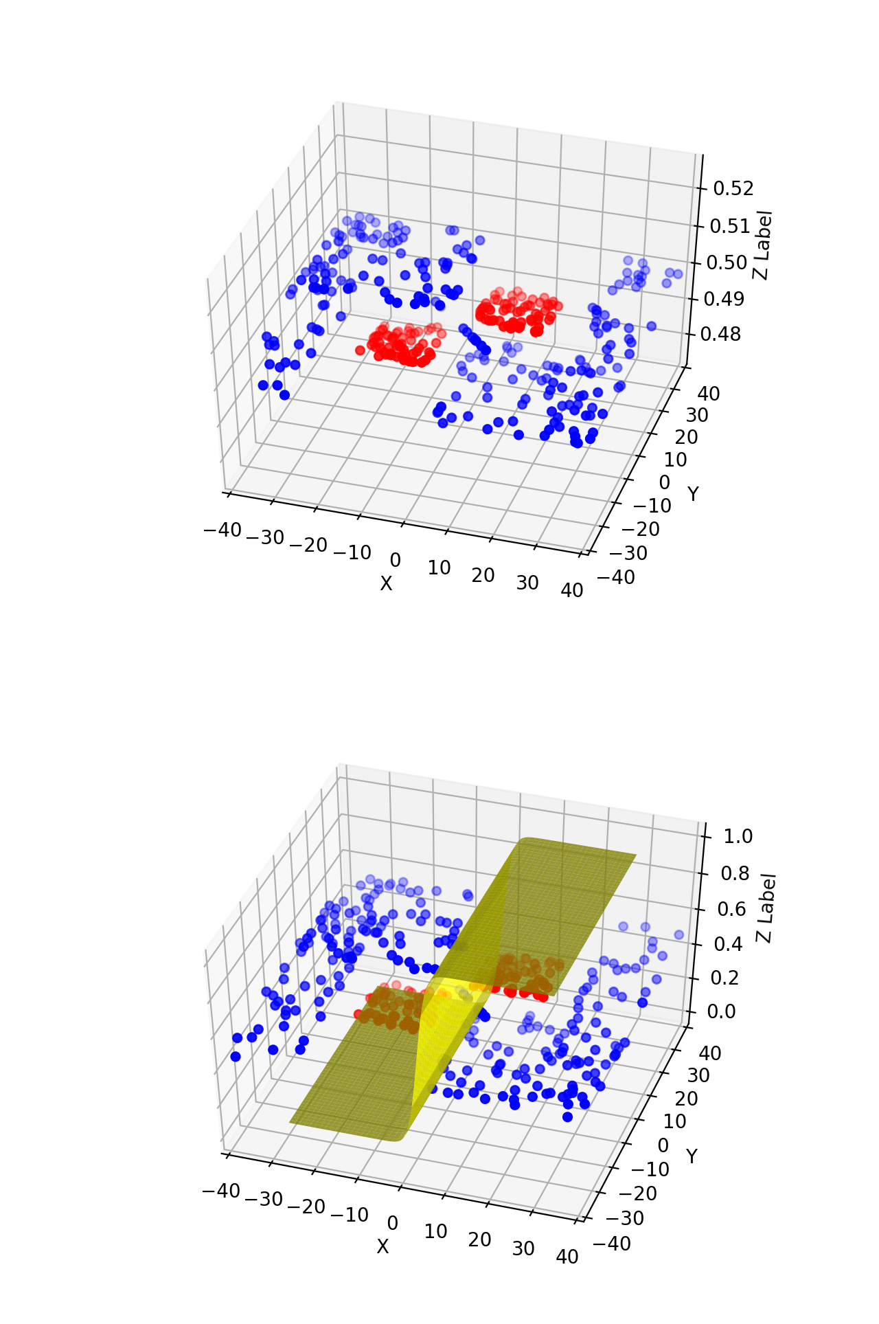
This is what we actually want
The illustrative proof that we just saw tells us that we can have a neural network with two hidden layers which can approximate the above function by a sum of towers
Which means we can have a neural network which can exactly separate the blue points from the red points !!
CS7015 (Deep Learning) : Lecture 3

